Slide 1




Shuttle
Startup
Pitch Deck
Presented by NAN

Slide 2
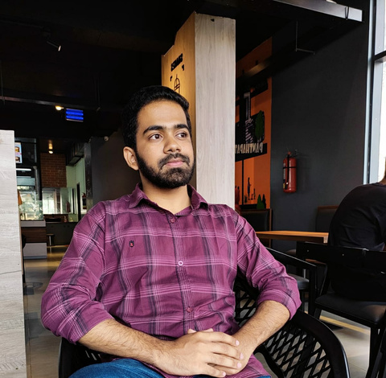
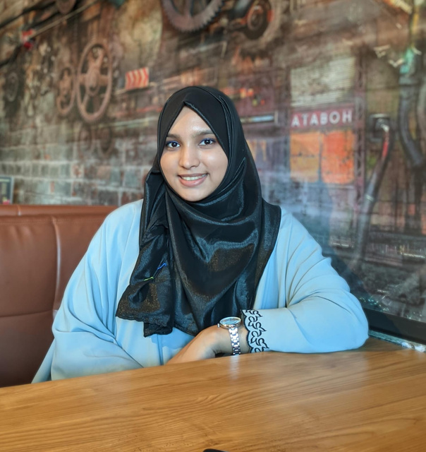
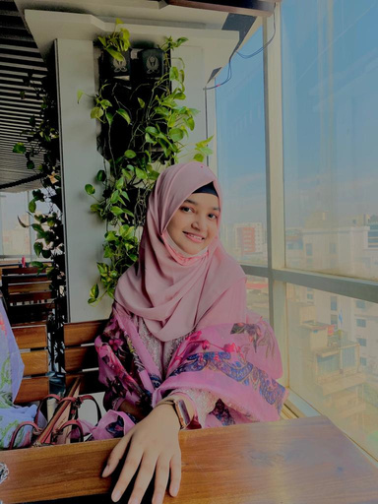
OUR TEAM
Ashab Asir
Team Leader
Safayete Nava
Jannatul Niha
Frontend Engineer
Backend Engineer

Slide 3
TABLE OF CONTENTS
Introduction
Meet Our Team
Problem
Solution
Objective
Purpose
Features of application
Benefits of application

Slide 4

INTRODUCTION

Slide 5




PROBLEMS
TRAFFIC JAM
CROWDED PUBLIC TRANSPORT
ENVIRONMENT POLLUTION

Slide 6







BRING PEOPLE
SAVE MONEY & REDUCE NUMBER OF CARS
LESS TRAFFIC, LESS POLLUTION

Slide 7





BACKGROUND
START FOR WOMEN
EXPENDE FOR CORPORATE
SERVICE FOR STUDENT
SERVICE FOR TRAVELER

Slide 8




WHY SHUTTLE
EASY
SAFE
ENVIRONMENT FRIENDLY

Slide 9




GOALS
AFFORDABLE PRICE
IMPROVE CITY
KEEP SAFE

Slide 10




SAVE TIME
PURPOSE
TRAVEL BETTER
SAVE MONEY
CREATE OPPERTUNITIES

Slide 11






FEATURES OF SHUTTLE
DIVERSE OPTIONS
HELP SCHOOLS
HELP TRAVELERS
SMART RIDE SHARE
STEADY INCOME

Slide 12
THANK YOU

